Slide 1
Generating Preview Tables for Entity Graphs
#Ning Yan, *Sona Hasani, *Abolfazl Asudeh, *Chengkai Li
#Huawei U.S. R&D Center
*University of Texas at Arlington, Innovative Database and Information Systems Research (IDIR) Laboratory
SIGMOD 2016, June 30th, 2016
Notes:
Good afternoon!
My name is Sona Hasani. I am a PhD student at the University of Texas at Arlington.
The paper I am presenting is “generating preview tables for entity graphs”.
Other authors on the paper include Ning Yan, now at Huawei, Abolfazl Asudeh and Chengkai Li.

Slide 2
Ultra-heterogeneous Entity Graphs
Large and complex graphs capturing millions of entities and billions of relationships between entities.
Entity
Will Smith
FILM ACTOR
FILM PRODUCER
Applications: search, recommendation systems, business intelligence, health informatics, fact checking
Freebase : 1.9 billion triples
DBpedia : 3 billion triples
YAGO : 120 million triples
Linked Open Data : hundreds of datasets 52 billion RDF triples
I, Robot
FILM
Entity Type
Executive Producer
Actor
Science Fiction FILM GENRE
Genres
Men in Black
FILM
Genres
Action Film
FILM GENRE
Director
Producer
Relationship
Barry Sonnenfeld
FILM DIRECTOR
Laurie MacDonald
FILM PRODUCER
Notes:
Let me start with a brief introduction of entity graphs.
In an entity graph, nodes represent entities.
Each entity belongs to one or more entity types.
Edges represent the relationships between entities.
In this example, Will Smith is an entity that belongs to types Film Actor and Film Producer and he is an Actor in Men in Black.
Today, there are many large and complex entity graphs. Some contain millions of entities and billions of relationships. Examples include Freebase, Dbpedia, YAGO, and Linked open data which connects hundreds of RDF datasets.
Entity graphs are being used in important applications such as search, business intelligence, health informatics, Fact checking and so on.

Slide 3




Steep Flag-Down Cost
Find a dataset
Does it provide the required information?
Start building applications
Put effort and time to read the documents
Download a few hundred Gigabytes of data
Learn the dataset’s structure and upload it into a database
Notes:
However, it is not easy at all to start using these large datasets in your applications.
For that, you will need to
1. First find a dataset, maybe through an online catalog.
2. Read its online documentation to know more about the data. Oftentimes such documents may not be available.
3. You may need to download a few hundred gigabytes of data or even more, which may not always be free.
4.Then you will learn the dataset’s structure and meta-data and upload it into database.
5. And finally you have to look into the data and decide if it fits your application’s needs.
If not, you will need to go through this process again.

Slide 4
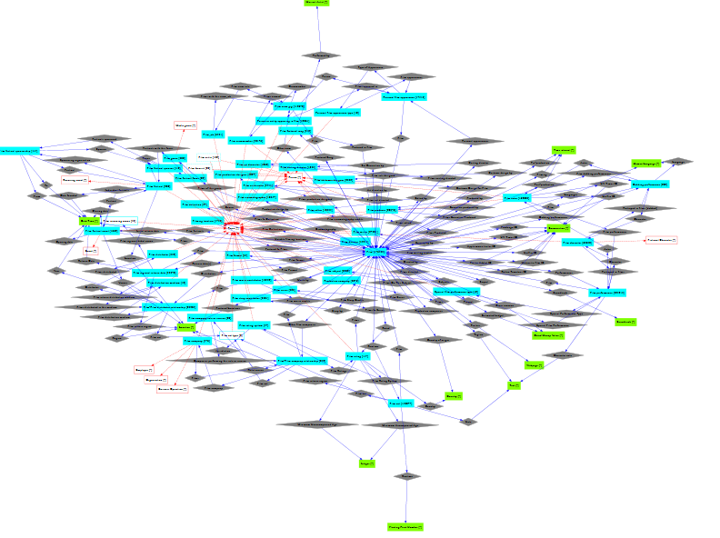
Need for a Quick Overview
Approach 1: Schema Graph
Schema graph itself can be too complex
AWARD
Award Winners
FILM ACTOR
Actor
FILM
ExecutiveProducer
Director
FILM DIRECTOR
Producer
FILM PRODUCER
Genres
FILM GENRE
Schema graph of “Film” domain in Freebase
Entity graph: 2M entities, 18 M edges
Schema graph: 63 entity types ,136 edges
Notes:
It will be really helpful if we can attain a reasonable high-level overview of an entity graph in a short amount time, before we even download the data.
Such a quick overview can be in the form of a schema graph. On the left of this slide is the schema graph of the entity graph we saw earlier.
In a schema graph, nodes represent entity types instead of entities, and edges represent relationship types between entity types. Every edge has at least one instance edge in the entity graph.
The problem with this approach is even a schema graph can be still too big and complex.
For instance, on the right, you see the schema graph of domain “film” in Freebase. It is orders of magnitude smaller than the corresponding entity graph, but it has 63 nodes and 136 edges.

Slide 5
Need for Quick Overview
Approach 2: Schema Summary
Schema summarization in relational database [Yang PVLDB09, Yang PVLDB11]
Cluster tables in relational database by their semantic roles and similarities.
Clusters tables, not relationships
Detailed
XML summarization [Yu VLDB06]
Provide a succinct overview of the entire schema graph
Graph summarization [Tian SIGMOD08, Zhang ICDE10]
Group graph nodes based on their attribute similarity and allow users browse the summary from different grouping granularities.
Notes:
Another approach is to come up with a schema summary.
There have been works in recent years on schema summary for relational databases, XML and graphs.
We implemented the method by Yang and others in their VLDB 2009 paper and compared its results with that of our method.

Slide 6
Preview Tables
Key attributes
Non-key attributes
Award Winners
Executive Producer
Saturn Award
AWARD
Will Smith
FILM ACTOR FILM PRODUCER
I, Robot
FILM
FILM ACTOR | Award Winners
Will Smith | Saturn Award
Actor
Actor
Genres
Men in Black II
FILM
Genres
Action Film
FILM GENRE
Genres
Men in Black
FILM
Genres
Genres
Science Fiction FILM GENRE
Director
Director
Producer
FILM | Director | Genres
Men in Black | Barry Sonnenfeld | {Action Film, Science Fiction}
Men in Black II | Barry Sonnenfeld | {Action Film, Science Fiction}
I, Robot | _ | Action Film
Barry Sonnenfeld
FILM DIRECTOR
Laurie MacDonald
FILM PRODUCER
Notes:
What’s proposed in our paper is a way of summarizing schema graphs using a concept called “Preview tables”.
A preview consists of several preview tables.
The first column of each preview table, in light orange color, refers to an Entity type. We call it the “key attribute”. The remaining columns, in light blue color, are called the “non-key attributes”. They refer to the relationships between the key attribute and its important adjacent entity types.
Each preview table also comes with a few randomly selected sample tuples, to help users gain a better understanding of the actual data.
One thing to note is the multi-values and null-valued cells in the tables. This is because the entity graph can be ultra-heterogeneous.

Slide 7
Too Many Previews. Which one to Choose?
Many possible previews
Different choices
Preview A
Preview B
FILM | FILM SET DECORATOR | FILM EDITOR
FILM | FILM DIRECTOR | FILM PRODUCER
PRODUCTION COMPANY | FILM
FILM WRITER | FILM
Notes:
As we mentioned there can be a large number of entity types and relationship types in a schema graph.
That gives us many different choices in producing a preview. They will differ in sizes and in the selection of key and non-key attributes.
Therefore we need a way to rank possible previews.

Slide 8
Scoring Measures
Score of the Preview
FILM | Actor | Genres
4 | 6 | 5
+
4 × (6+5) = 44
60
FILM ACTOR | Actor | Award Winners
2 | 6 | 2
2 × (6+2) = 16
Key attribute scoring
Coverage-based method
Random walk-based method
Non-key attribute scoring
Coverage-based method
Entropy-based method
Notes:
For ranking previews, we propose a suite of scoring measures.
The score of a preview table is simply the product of its key-attribute score and the summation of its non-key attribute scores.
And to calculate the total score of a preview, we simply sum up the individual tables’ scores.
For key-attribute scoring we studied a Coverage-based method and a random walk-based method. For non-key attribute scoring, we studied a coverage-based method and an-entropy based method.
Details of these scoring measures can be found in the paper.
I’d like to point out that the optimal preview discovery algorithm, which I will talk about momentarily, is oblivious about the key and non-key attribute scoring measures and it can work with any monotonic function for aggregating the individual scores.

Slide 9
Optimal Preview Discovery
Find the preview with highest score that satisfies
Size constraint
Number of key attributes K
Number of non-key attributes N
Distance between two preview tables d
Tight Diverse
dist(Ti, Tj) ≤ d
Concise
dist(Ti, Tj) ≥ d
FILM | Performances | Genres | Directed By
FILM FESTIVAL | Location | Focus
FILM DIRECTOR | Films Directed
FILM COMPANY | Films
FILM PRODUCER | Films Produced
FILM CHARACTER | Portrayed in Film
Tight
Diverse
Notes:
The algorithmic problem studied in the paper is the “Optimal Preview Discovery” problem.
Its goal is to find the preview with highest score, under constraints on preview size and distance between preview tables.
A concise preview can have at most K key attributes and N non-key attributes.
A tight preview must further satisfy a distance constraint --- the distance between every two key attributes in the schema graph is smaller than a threshold d.
On the other hand, for a diverse preview, the pair-wise key-attribute distance must be greater than d.

Slide 10
Preview Discovery Algorithms
Concise preview
Dynamic programming algorithm
Tight/Diverse preview
NP-hard
Apriori-like algorithm
Clique(G,k)
TightPreview (Gs, k, k, 1, 0)
DiversePreview (Gs, k, k, 2, 0)
Notes:
The brute-force approach to the Optimal Preview Discovery problem will enumerate all possible previews and choose the one with the highest score.
That is apparently not practical, given the sheer sizes of entity graphs.
In the paper we studied two algorithms --- a dynamic programming algorithm for concise previews, and an algorithm for Tight and Diverse previews, inspired by the Apriori principle in frequent itemset mining.
I’d like to point out that the problem for Tight and Divers previews is NP-hard. It can be proved by reduction from the Clique problem. The details are in the paper.

Slide 11
Experiments
Dataset: Freebase
Accuracy of scoring measures
Compared with Freebase ground truth:
Key attributes: Precision-at-k (p@k), Average Precision, Discounted Cumulative Gain (nDCG)
Non-key attributes: Mean Reciprocal Rank (MRR)
Compared with crowd ranking:
Pearson Correlation Coefficient (PCC)
Efficiency of algorithms
Execution time
User study
Existence test questions
User experience questions
Notes:
We conducted experiments to evaluate three things: (1) the accuracy of the scoring measures, (2) the efficiency of our algorithms, and (3) the usability of the produced previews.
In the next several minutes, I will mention a few results.
*** To save time, perhaps no need to say more. But, in later slides, you need to explain what is “Freebase ground truth”, “crowd ranking” and “existence test, user experience questions” ***

Slide 12
Key Attribute Scoring (p@k)
YPS09 [Yang PVLDB09]
Notes:
In these figures, we compare the accuracy of our key-attribute scoring measures --- Coverage and Random-walk --- with YPS09, which is one of the schema summarization papers I mentioned earlier.
We use precision-at-k as the accuracy measure.
The ground truth is from 5 domains in Freebase. In its website, for each domain, Freebase used to display 6 entity types and up to 3 relationships per entity type. They are similar to preview tables, although we believe they were manually produced.
The figures show that the measures we used have substantially higher precision-at-k than YPS09, and they got very close to the maximally-possible precision-at-k in 4 out of 5 domains.
*** “YPS09 [Yang PVLDB09]” ***

Slide 13
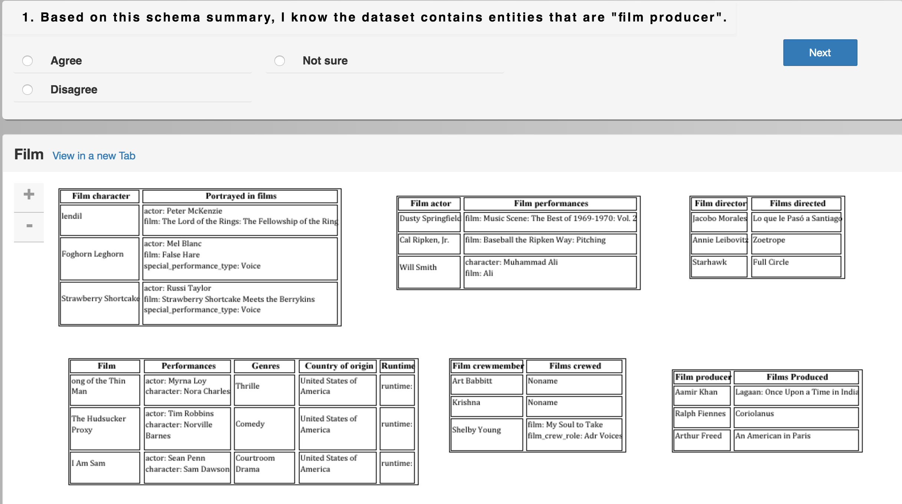
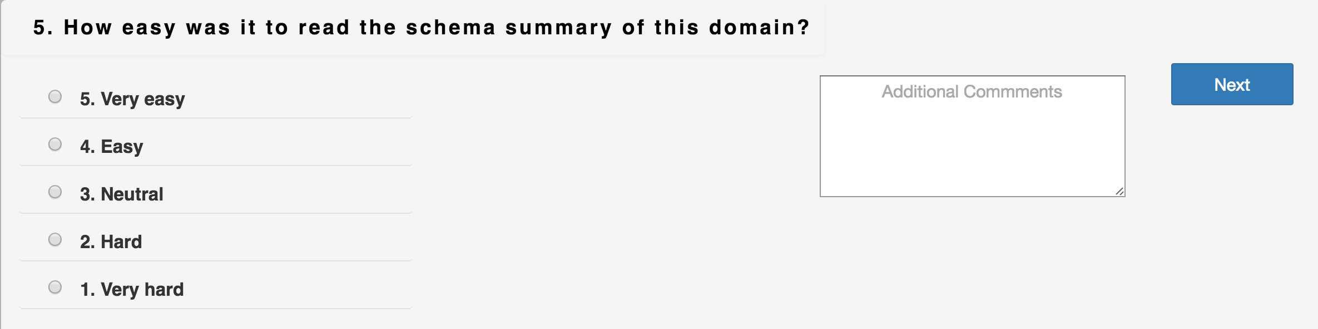
User Study, Approaches Compared
Domains: film, books, music, TV, people
Approaches:
Schema graph
Concise preview
Tight preview
Diverse preview
Freebase ground truth
YPS09
Hand-crafted preview tables
4 existence questions
4 experience questions
84 Master’s and PhD students in database area
$15 gift card
Notes:
We implemented a platform to conduct a user study on 7 different approaches using 5 Freebase domains.
The approaches include
Schema graph
Concise preview
Tight preview
Diverse preview
Freebase ground truth
YPS
Hand-crafted preview tables
For each domain and each approach, we asked a few participants 4 existence test questions and 4 user experience questions.
The existence test questions ask the participants to find a specific piece of information in the schema summary.
The user experience question asked the participants about their general experience with the approaches they used.
** To save time, don’t discuss the selection of and reward to participants. ***

Slide 14
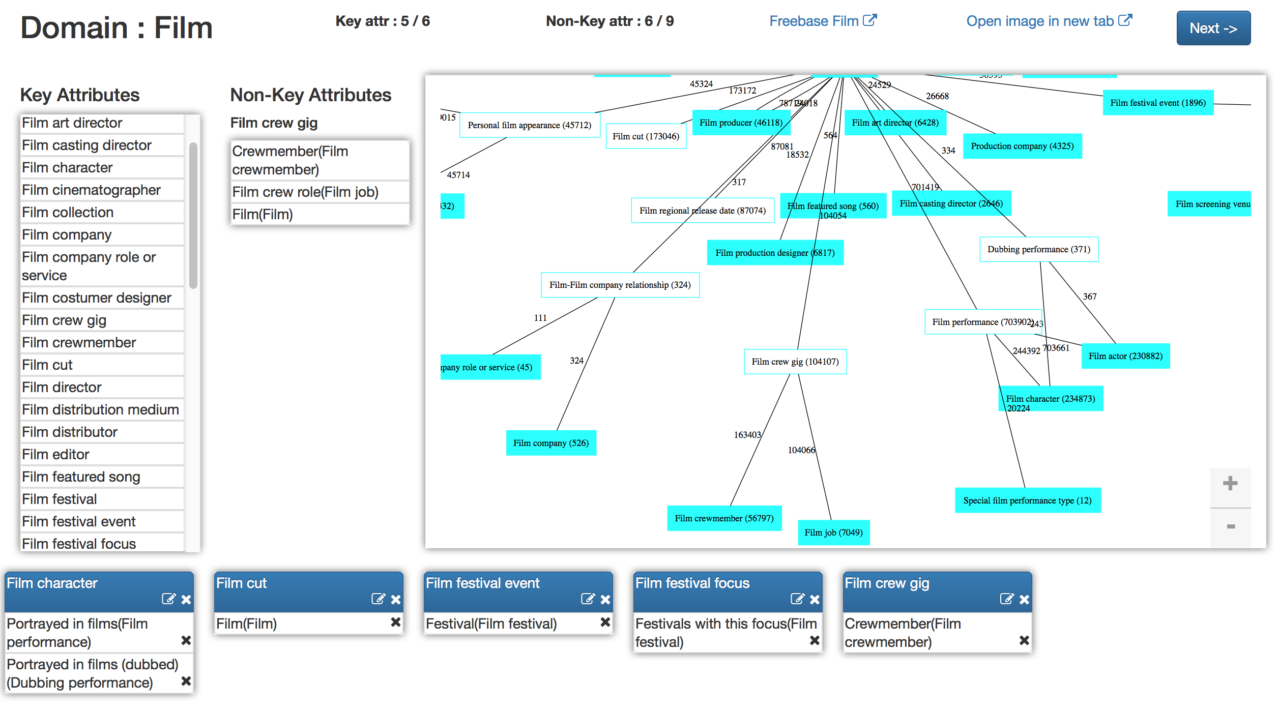
User Study, Hand-crafted Preview Tables
Domains: film books music TV people
Hand-crafted preview tables
10 PhD students in Database research group
Individually and as a group
$20 gift card
Notes:
Here is a screenshot of the website we developed for collecting the previews based on the last approach, hand-crafted preview tables.
We explained the concept of preview tables to 10 database PhD students.
Then we provided them the schema graphs and the list of possible key and non-key attributes.
And we asked them to generate previews under given size constraints.
There participants first generated preview tables individually.
They then discussed and produced previews as a group.
*** If time runs out, you can skip this slide. ***

Slide 15
User Study: Existence Test Questions
 | Tight | Diverse | Freebase | Experts | YPS09 | Schema Graph
Concise | z=1.59 p=0.0559 | z=−2.28 p=0.0113 | z=0.49 p=0.3121 | z=−0.13 p=0.4483 | z=0.36 p=0.3594 | z=−0.43 p=0.3336
Tight |  | z=−3.48 p=0.0003 | z=−1.12 p=0.1314 | z=−1.69 p=0.0455 | z=−1.282 p=0.0999 | z=−1.93 p=0.0268
Diverse |  |  | z=2.57 p=0.0051 | z=2.10 p=0.0179 | z=2.60 p=0.0047 | z=1.70 p=0.0446
Freebase |  |  |  | z=−0.61 p=0.2709 | z=−0.15 p=0.4404 | z=−0.87 p=0.1922
Experts |  |  |  |  | z=0.49 p=0.3121 | z=−0.29 p=0.3859
YPS09 |  |  |  |  |  | z=−0.77 p=0.2206
Pairwise comparisons of conversion rates, domain=“music”, α=0.1
Notes:
We conducted a significance test on the participants’ accuracy on the existence test questions when they used the 7 different approaches.
For each pair of approaches, the Z-value and p-value are given in the corresponding cell of this table, at the significance level of 0.1.
If a cell is in blue, it means the approach in the row wins; in orange, the one in the column wins.
“Tight” preview shows significantly higher accuracy compared to all other approaches, except the Freebase ground truth.
The “Diverse” preview was disappointing in this case, as it lost to every other approach.

Slide 16
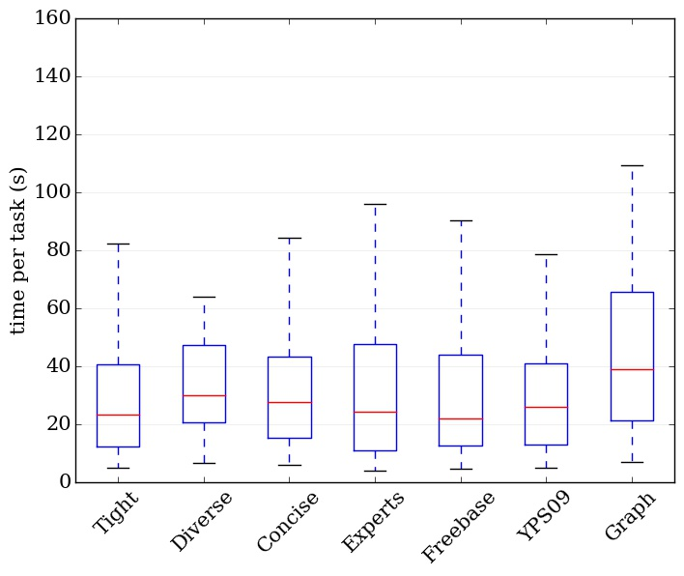
User Study: Existence Test Questions
Time taken on existence tests, domain=“music”
Notes:
In this slide you see the distribution of the time spent by participants on the existence test questions.
Tight seems to works very well and close to Freebase ground truth.
Schema Graph on the other hand had the worst performance. It could be that, due to its complex structure, it takes more time for participants to find a specific piece of information.
*** If time runs out, you can skip this slide. ***

Slide 17
User Study: User Experience Questions
Questions
How easy was it to read the schema summary? | Freebase | Diverse | Graph | Experts | YPS09 | Concise | Tight
How much understanding of the data can you gain from it? | Graph | Freebase | YPS09 | Diverse | Concise | Tight | Experts
How helpful was it in assisting you to understand the data? | Graph | Freebase | YPS09 | Diverse | Experts | Concise | Tight
Is it missing important information? | YPS09 | Concise | Experts | Graph | Tight | Freebase | Diverse
most favorable
least favorable
Systems sorted by average user experience scores across five domains
Notes:
This table shows the results from the user experience questions.
These questions ask the participants how easy it was to read the schema summary produced by the approach they used, how much understanding of the data they gained, and so on.
Interestingly, the results seem to be negative in general, and they contradict with the conclusion one many make based on the results on existence test questions, which we just discussed.
For instance, while the participants using tight preview had higher accuracy than participants using all other approaches except Freebase ground truth, the participants themselves believed they acquired more understanding of the data using most other approaches.
Another observation is that even the preview tables hand crafted by expert users were perceived poorly. This shows how challenging it is to produce such previews.
These contradictions and observations are worth further investigation.
*** I don’t think you have time to discuss the details. So the following explanation can be removed. ***
While time box plots show that participants of tight preview answered faster than other approaches, they did not think that it was easy to understand the schema summary.
Another interesting outcome is that even though the conversion rate test showed that participants of tight did better than other participants in correctly answering the questions, they believed that they acquire more understanding of the data using Graph and YPS.
And finally regarding the last question, participants favored YPS the most. One logical explanation might be its more complex structure.

Slide 18



Acknowledgment
Disclaimer: This material is based upon work partially supported by the National Science Foundation Grants 1018865, 1408928 and the National Natural Science Foundation of China Grant 61370019. Any opinions, findings, and conclusions or recommendations expressed in this material are those of the author(s) and do not necessarily reflect the views of the funding agencies.

Slide 19
Thank You! Questions?
Generating Preview Tables for Entity Graphs
Ning Yan, Sona Hasani, Abolfazl Asudeh, Chengkai Li

